Slide 1

Building Tesla’s Battery Range Calculator with Vue

Slide 2
Agenda workshop
What is Vue?
Virtual DOM
Component tree
Create a component
Databinding
2 way databinding

Slide 3
Getting started
Clone or download:
https://github.com/petereijgermans11/workshop-reactjs-vuejs

Slide 4


Component based
Focused on the view layer (all browsers)
Integration with Angular or React
Small and compact (21 Kb)

Slide 5
Virtual DOM Vue.js and React both use virtual DOM, which makes it faster
Notes:
less expensive:
The changes are not made to the DOM, instead a replica of the DOM is created which is present in the form of JavaScript data structures. Whenever any changes are to be made, they are made to the JavaScript data structures and the latter is compared with the original data structure. The final changes are then updated to the real DOM.

Slide 6
root Vue Instance
var app = new Vue({
….
})
Notes:
To start with VueJS, we need to create the instance of Vue, which is called the root Vue Instance.

Slide 7
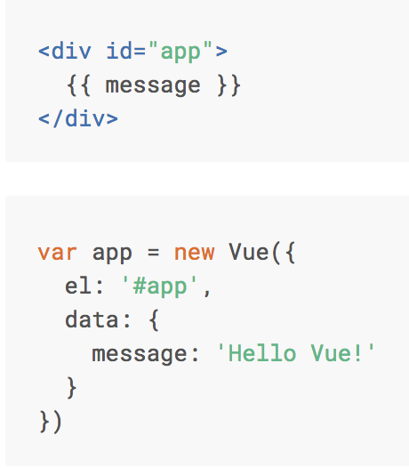

Basics Vue.js
Notes:
Here we create an instance of Vue.
For Vue, there is a parameter called el. It takes the id of the div-element.
Next, we have defined the data-object. It has a property : message -> value: ‘message’
This value will be rendered in the View via ‘interpolation’ {{}}

Slide 8
Interpolation
<span> Message: {{ message }} </span>

Slide 9
Databinding (one way)
<span> Message: {{ message }} </span>
<img v-bind:src=“url”> → <img :src=“url”>
<div v-on:click=”speedup"> → <div @click=”speedup"></div>
Notes:
Interpolation
v-bind → To assign the ’logo’ and ‘url’ attribute to HMTL tag, we need to use v-bind directive or colon.
v-on:click → We can use the v-on directive to listen to DOM events (onClick-events). Here with on-click event the function: speedup() will be called.

Slide 10
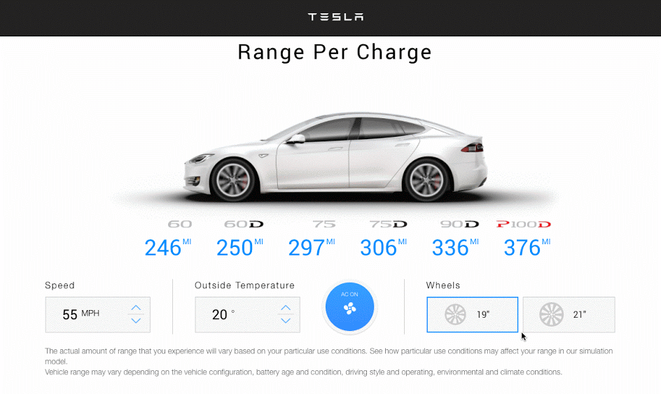

Slide 11
Live version
http://react-tesla-charge-calculator.surge.sh/

Slide 12
Component based A component adds logic to DOM elements
Notes:
Components are one of the important features of Vue.js that helps create custom elements, which can be reused in HTML.

Slide 13
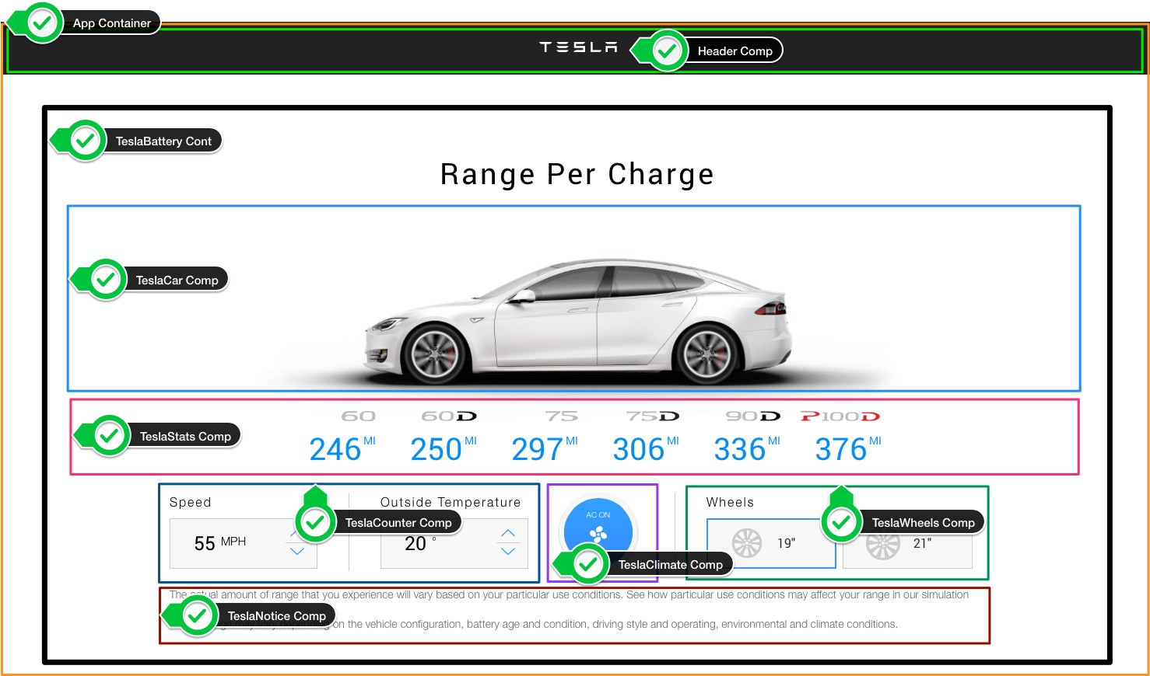

Slide 14
The UI is represented by a component tree
<App> -- Application entry point <TeslaHeader></TeslaHeader> <TeslaBattery> -- Container Component <TeslaCar /> -- Presentational Component <TeslaStats /> -- Presentational Component <TeslaCounter /> -- Presentational Component <TeslaClimate /> -- Presentational Component <TeslaWheels /> -- Presentational Component <TeslaNotice /> -- Presentational Component </TeslaBattery> </App>

Slide 15
Components tree
main.js
App.vue
TeslaBattery
→ Container Component
props
props
props
props
props
TeslaCar
TeslaStats
TeslaCounter
TeslaClimate
TeslaWheels
Presentational Components

Slide 16
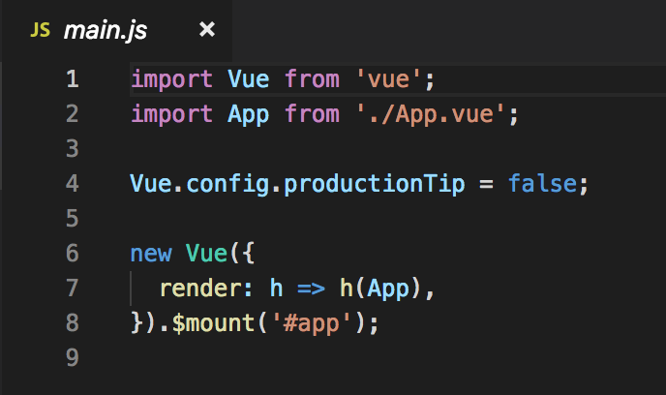
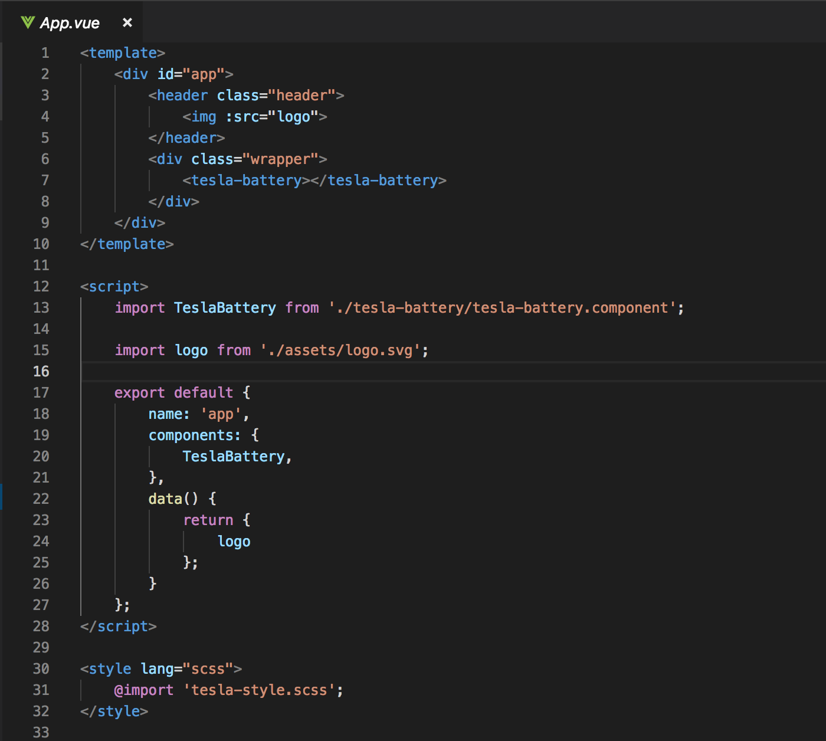
Entry Point
main.js
App.vue
Notes:
The main.js file is the entry point of the site, it is here that your first component is mounted and rendered.
App.vue is the first component mounted by Vue.
This component consist of the tesla-battery.component.

Slide 17
Tesla Battery Component

Slide 18
Components tree
Main.js
App.vue
TeslaBattery
props
props
props
props
props
TeslaCar
TeslaStats
TeslaCounter
TeslaClimate
TeslaWheels

Slide 19
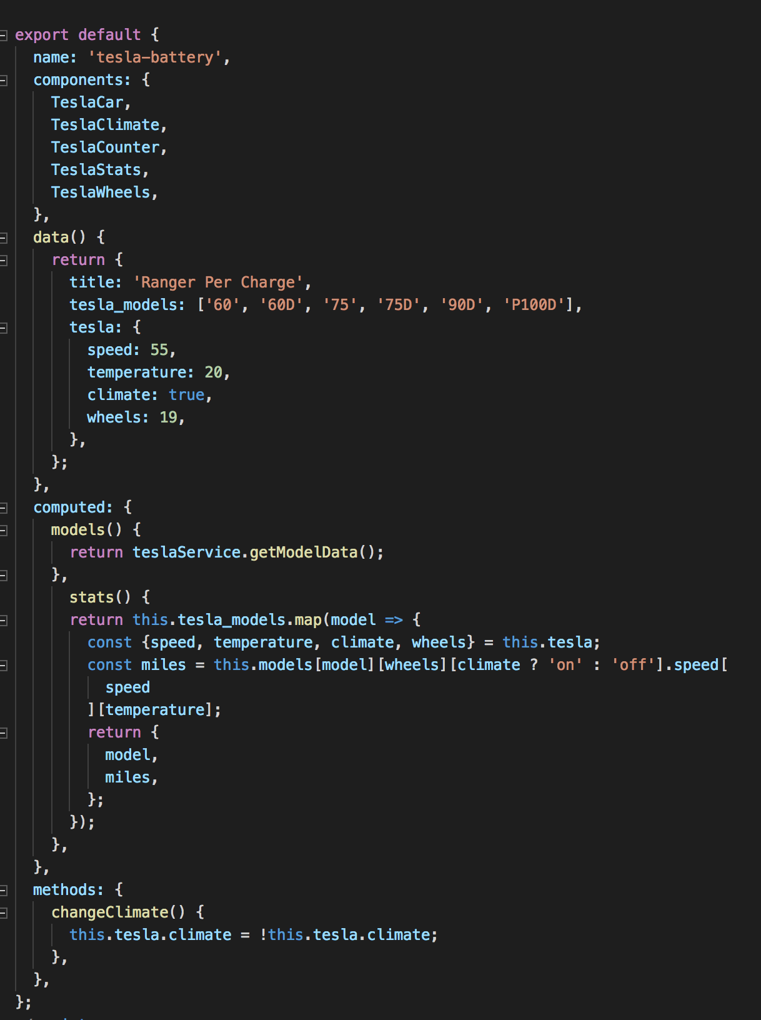
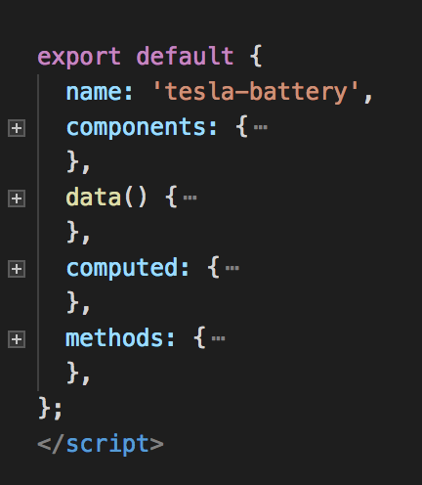
Tesla Battery Component
Notes:
This is the container component.
The tesla-battery.component: Provides data and actions to presentational components.

Slide 20
Tesla Battery Service

Slide 21
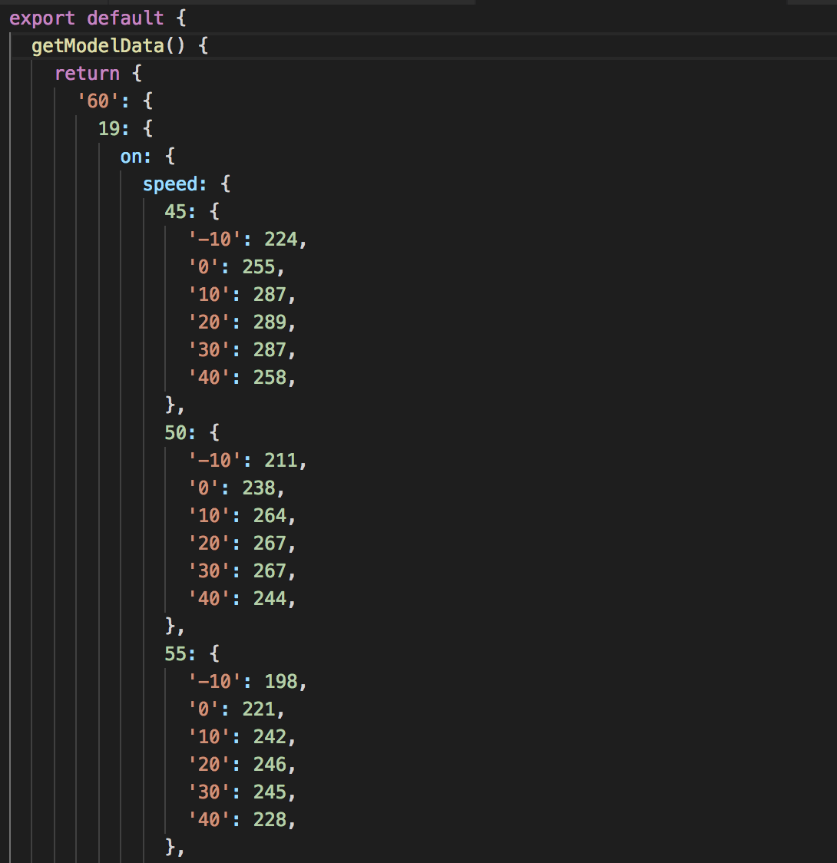
TeslaBattery.service
Data service
tesla_models = '60', '60D', '75', '75D', '90D', 'P100D’
Models –> wheels –> climate –> speed --> temparature

Slide 22
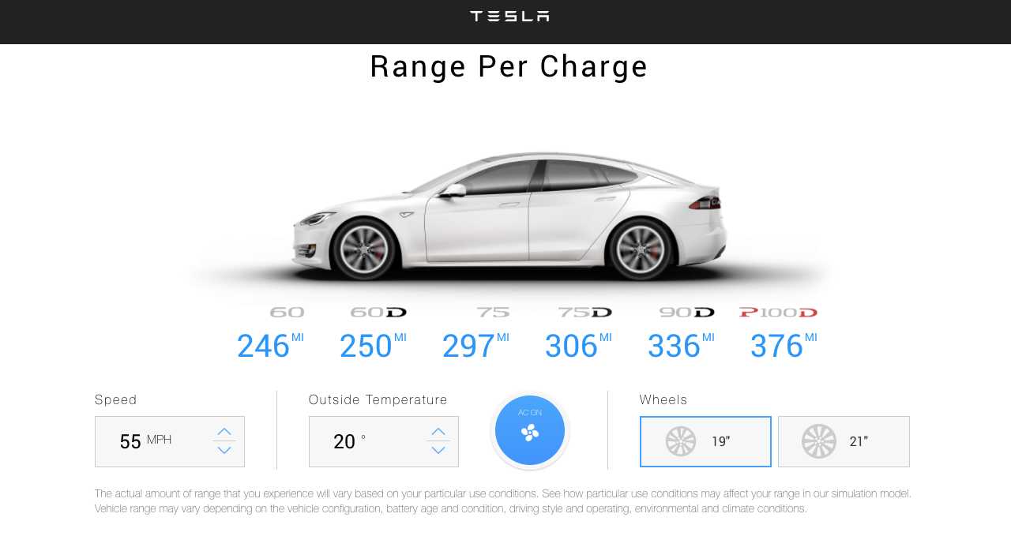
Exercise: check TeslaBattery.service model

Slide 23
Hints:
tesla-battery.component → stats()-method (for calculating the maximum battery range) is called when the following props changes (wheels – climate – speed - temparature)
tesla-battery.component → changed props (wheels – climate – speed - temparature) 2-way databinding for passing props →zie tesla-battery.component v-model en $emit → value

Slide 24
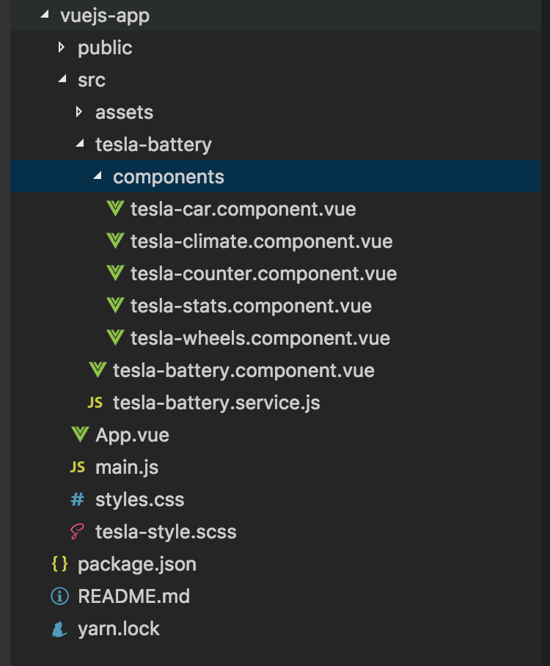

Slide 25
passing props to child components
Main.js
Use v-bind or :
to pass props
App.vue
TeslaBattery
props
props
props
props
props
TeslaCar
TeslaStats
TeslaCounter
TeslaClimate
TeslaWheels
Notes:
Get properties from parent component

Slide 27
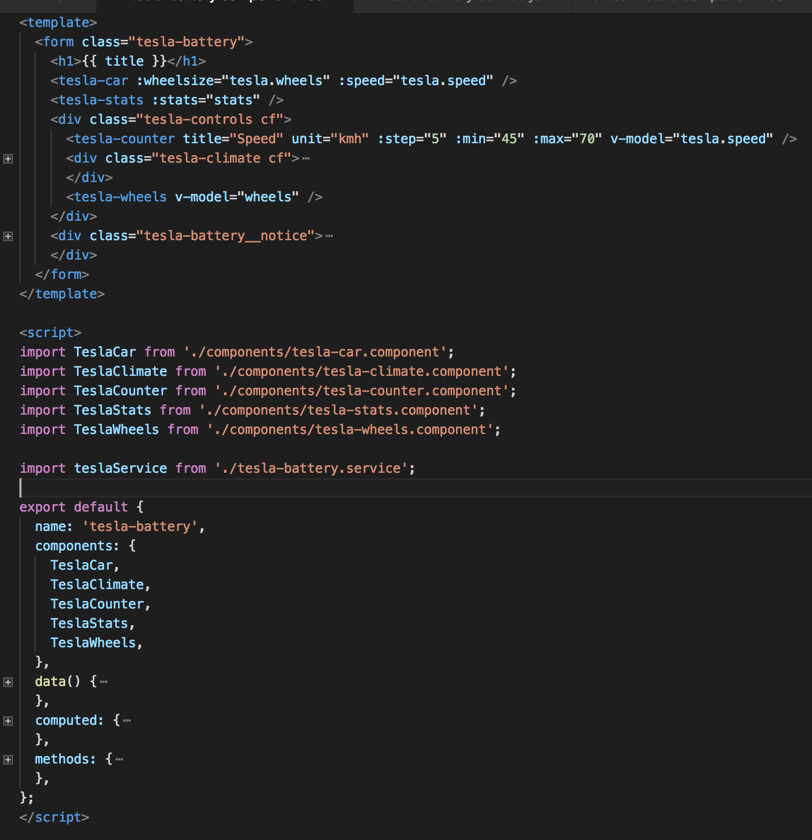
passing props to child components
:wheelsize = [19,21]
:speed = [45,50,55,60,65,70]
:stats = Array

Slide 28
props in Tesla Car Component

Slide 29
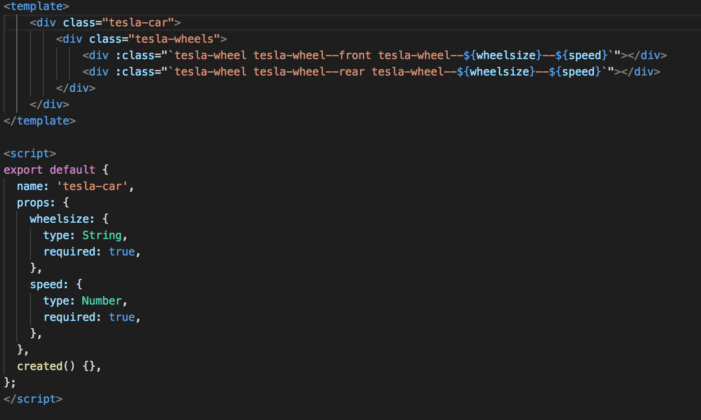
props in Tesla Car Component
<tesla-car :wheelsize="tesla.wheels" :speed="tesla.speed" />

Slide 30
Tesla Stats Component

Slide 31
passing props to child components
Main.js
Use v-bind or :
to pass props
App.vue
TeslaBattery
props
props
props
props
props
TeslaCar
TeslaStats
TeslaCounter
TeslaClimate
TeslaWheels

Slide 33
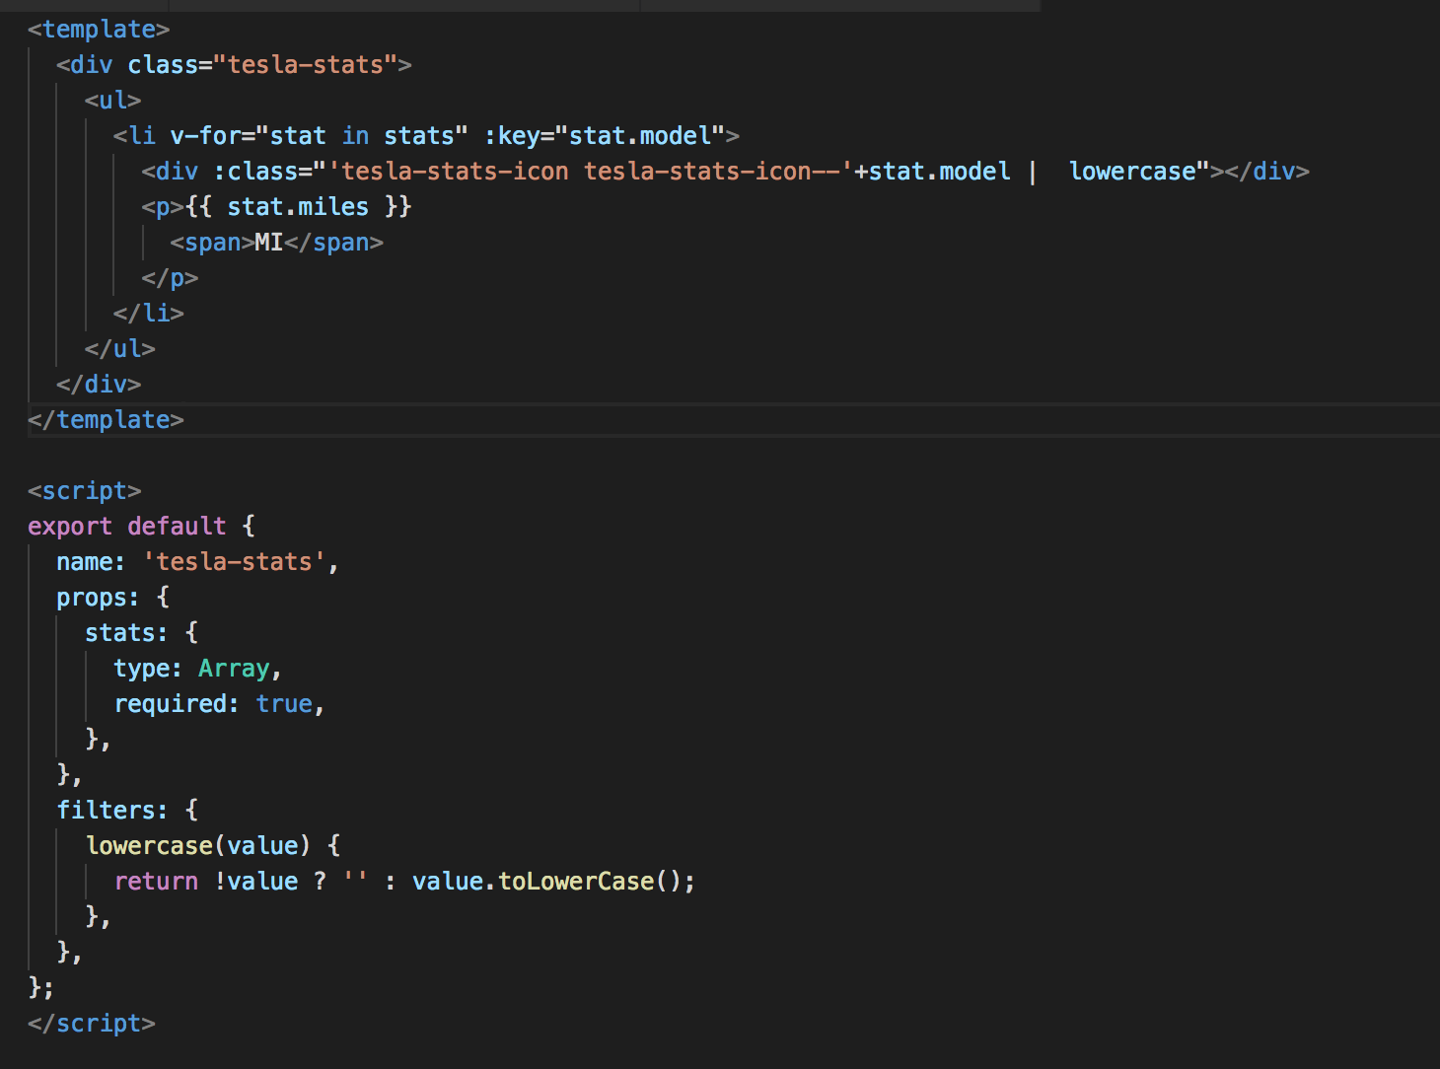
props in Tesla Stats Component
v-for in :key
:class
| lowercase
stats (type: Array)
filter lowercase

Slide 34
v-model (2-way databinding)
Components to be compatible with v-model:
accept a :value property
and emit an @input event when the user changes the value

Slide 35
v-model (2-way databinding)
v-model=“tesla.speed”

Slide 36
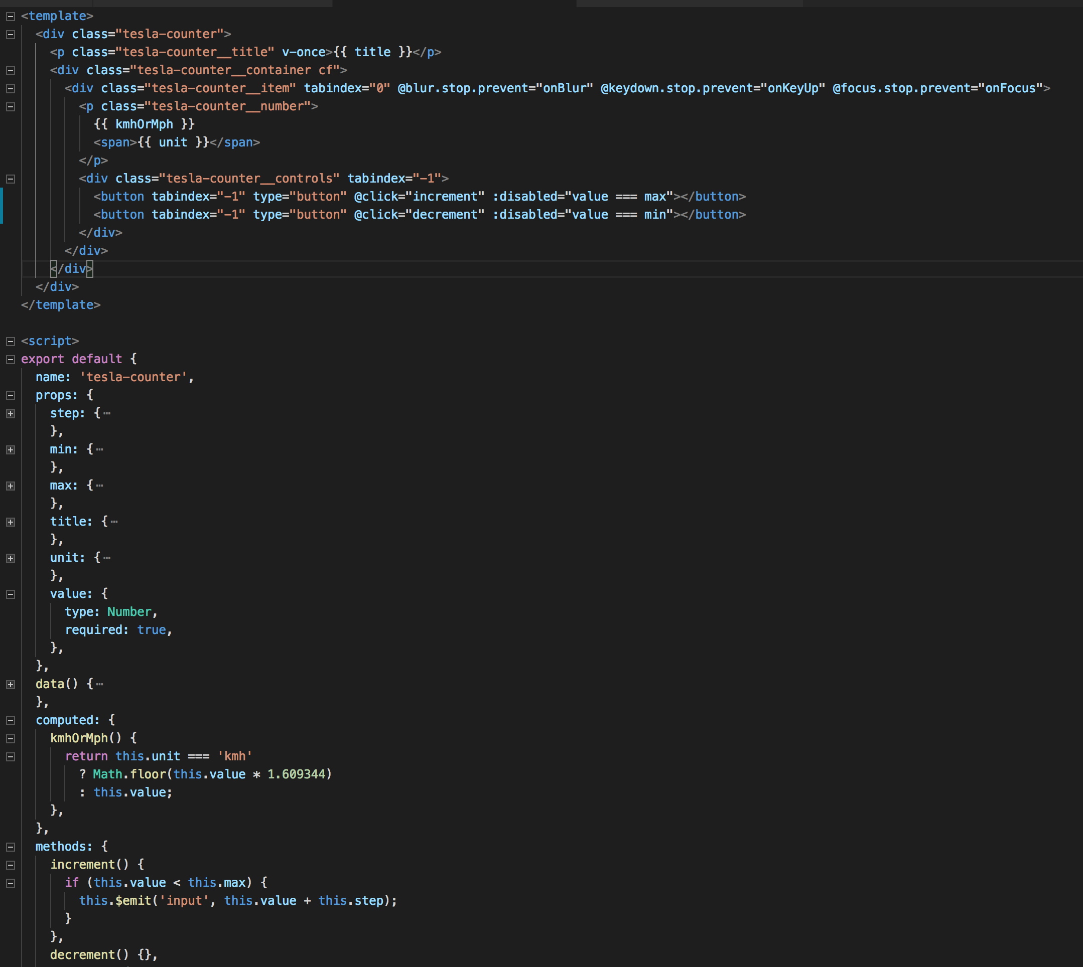
v-model in Tesla Counter Component
v-once
@keydown.stop.prevent
@click
kmhOrMph
:disabled="value === max”
this.$emit('input', this.value)
Notes:
The value/speed is emitted back to the parent component

Slide 38
How to create a tesla.header.component?
App.vue
props: “greeting”
TeslaHeader
TeslaBattery
props
props
props
props
props
TeslaCar
TeslaStats
TeslaCounter
TeslaClimate
TeslaWheels
Notes:
To create a tesla.header.component we will pass a ‘greeting’ property from the App.vue to the tesla.header.component

Slide 39
tesla-header.component
Step1 Create tesla-header.component.vue
Step 2 Import tesla-header.component in App.vue

Slide 40
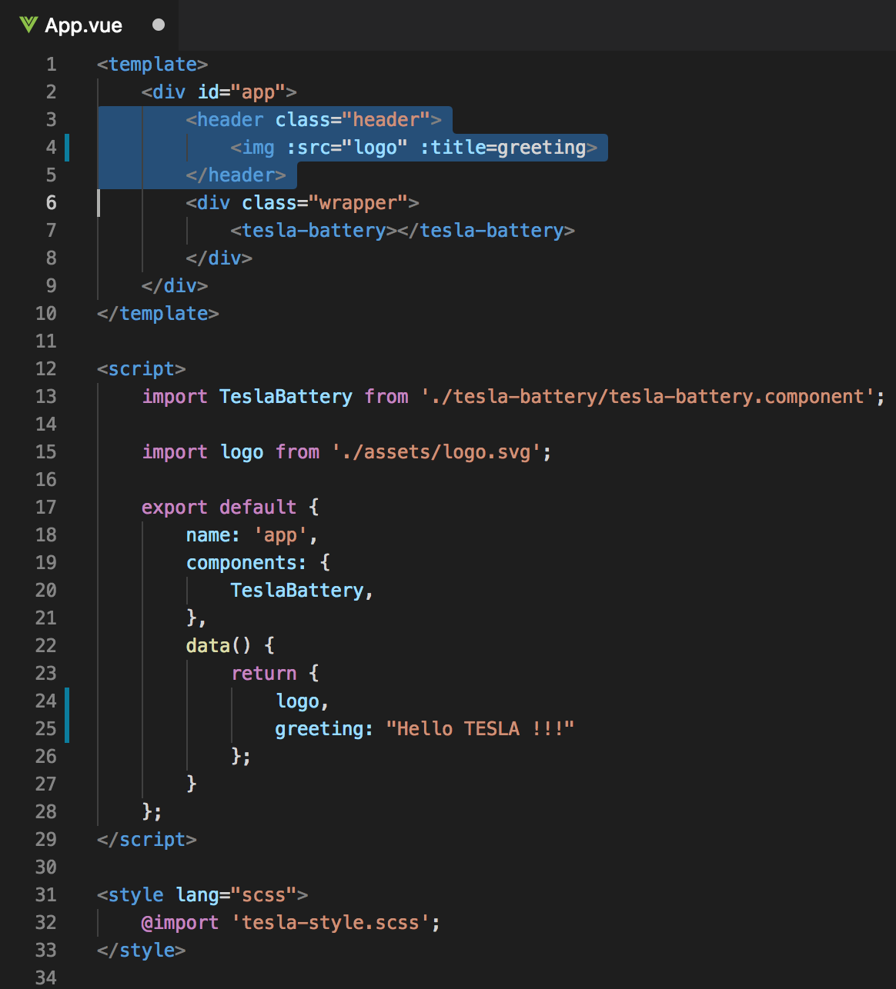
Current App.vue
<img v-bind:src=“logo” v-bind:title=“greeting”>
Notes:
We will store the img src in the data object
To assign the ’logo’ and ‘greeting’ attribute to HMTL tag, we need to use v-bind directive or colon.

Slide 41
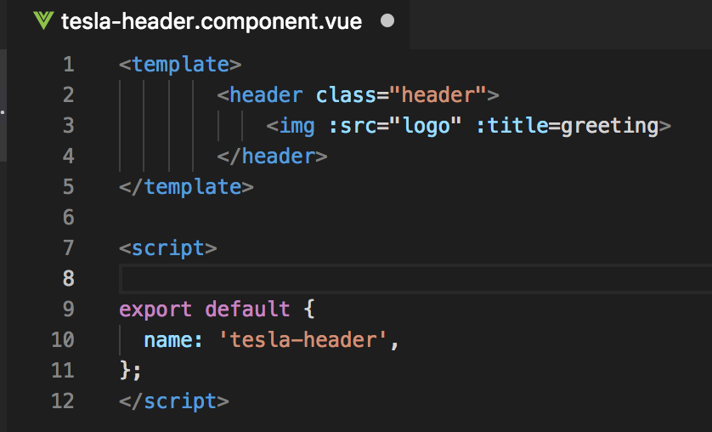
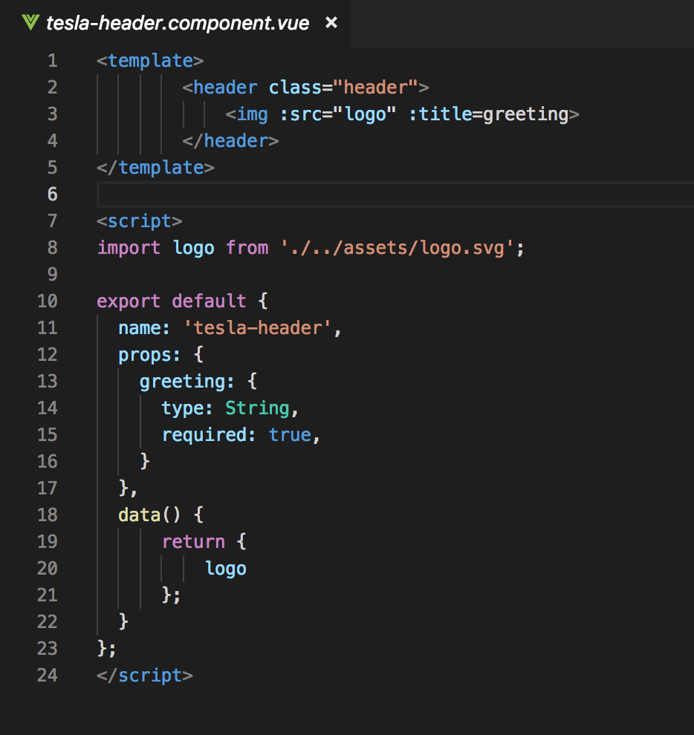
Step1 Create: tesla-header.component.vue
Notes:
Name
Props → logo

Slide 42
Components tree
App.vue
props: “greeting”
TeslaHeader
TeslaBattery
props
props
props
props
props
TeslaCar
TeslaStats
TeslaCounter
TeslaClimate
TeslaWheels

Slide 43
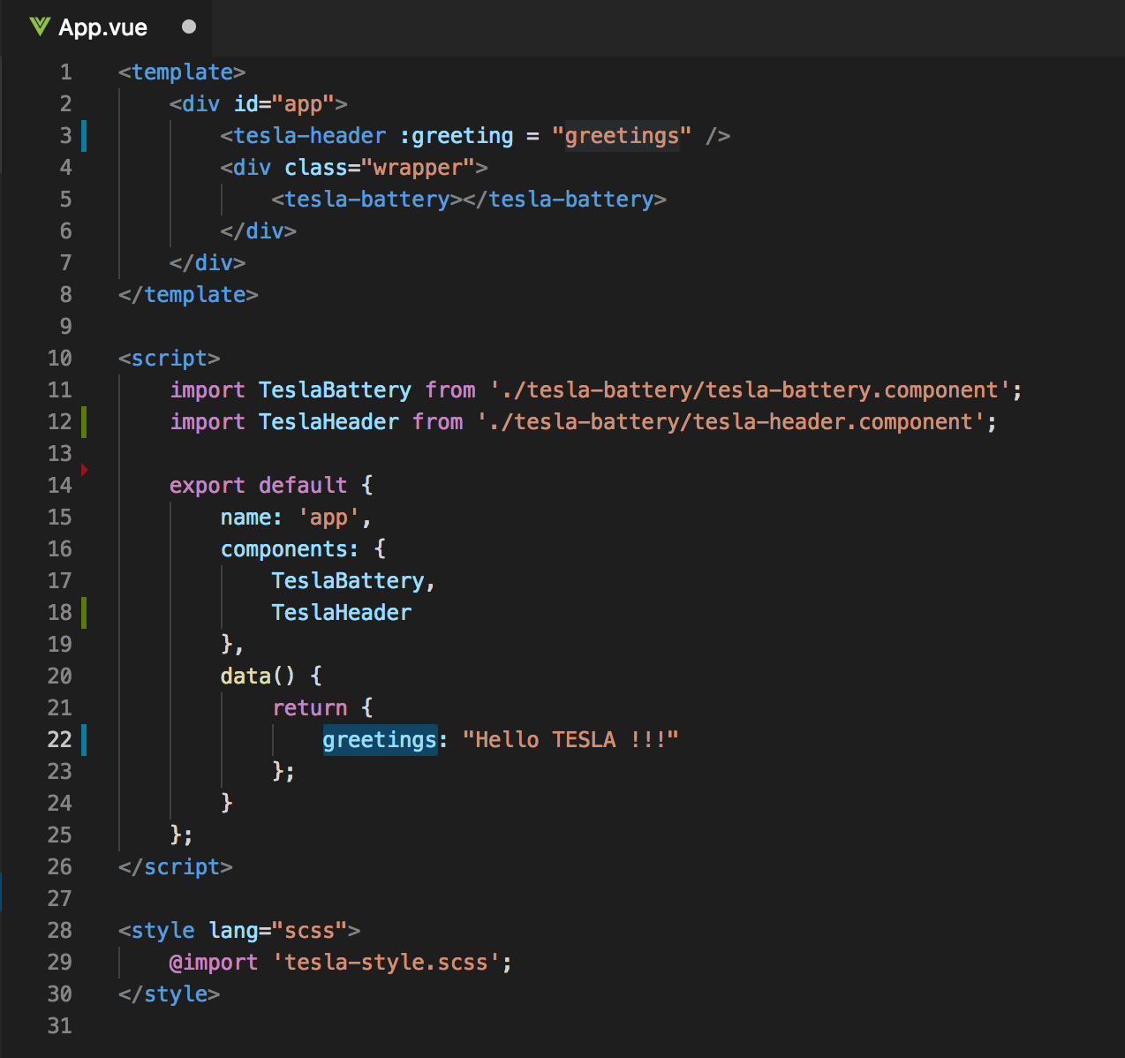
Step 2 Import tesla-header.component in App.vue
Old
New

Slide 44
Getting started
Clone or download:
https://github.com/petereijgermans11/workshop-reactjs-vuejs

Slide 45
Emit events
App.vue
props: “greeting”
TeslaHeader
TeslaBattery
emit
props
props
props
props
props
TeslaCar
TeslaStats
TeslaCounter
TeslaClimate
TeslaWheels

Slide 46
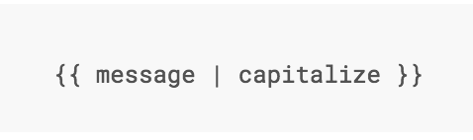
Filter
Notes:
Vue.js allows you to define filters that can be used to apply common text formatting.

Slide 47
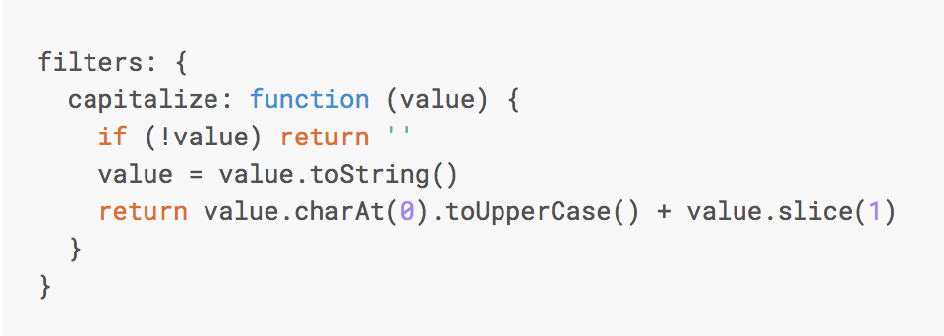
Custom Filter
Notes:
You can define local filters in a component’s options:

Slide 48
DIRECTIVES
Notes:
Directives are special attributes with the v- prefix. Directive attribute values are expected to be a single JavaScript expression (with the exception of v-for, which will be discussed later). A directive’s job is to reactively apply side effects to the DOM when the value of its expression changes.

Slide 49
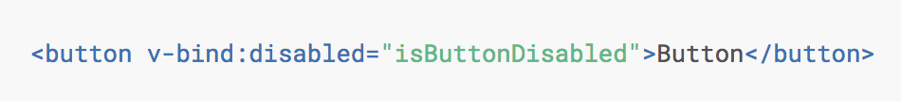
v-bind
Notes:
If isButtonDisabled has the value of null, undefined, or false, the disabled attribute will not even be included in the rendered <button> element.

Slide 50
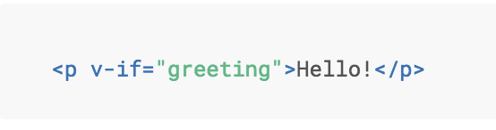
Directive v-if
Notes:
Here, the v-if directive would remove/insert the <p> element based on the truthiness of the value of the expression greeting.

Slide 51
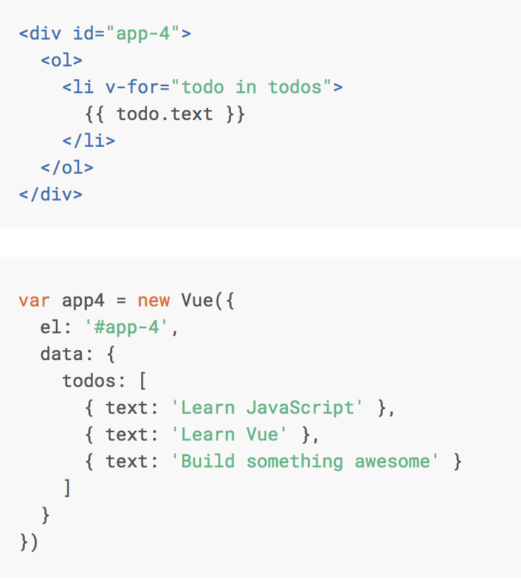
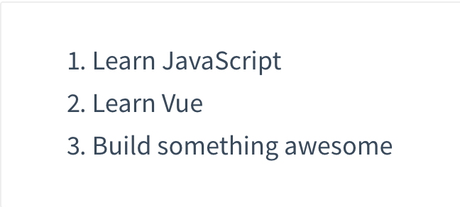
Directive v-for

Slide 52
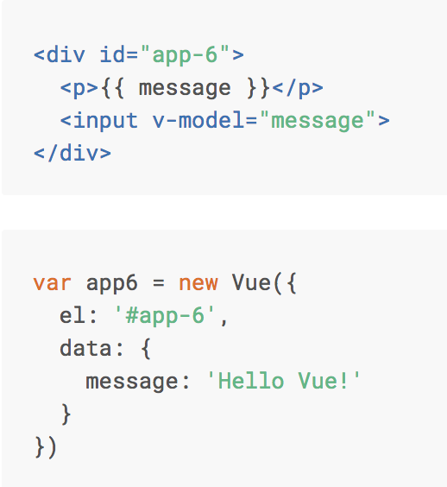
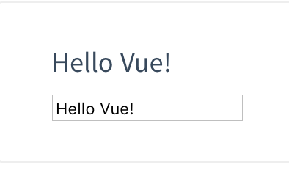
Directive v-model

Slide 53
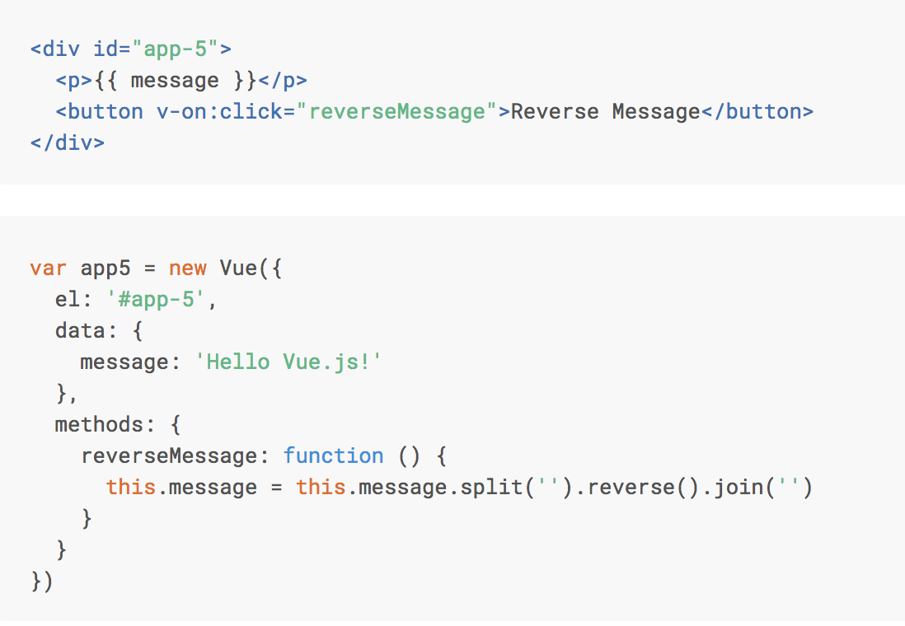
Directive v-on:click

Slide 54
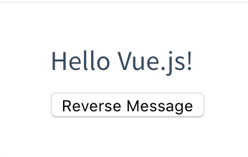
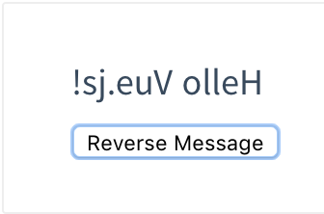
Directive v-on:click

Slide 55
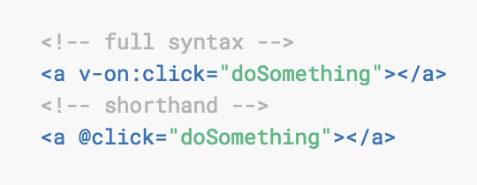
v-on:click Shorthand

Slide 56
@blur.stop.prevent

Slide 57
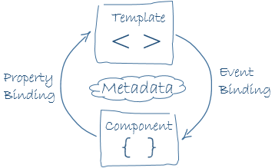
Data binding
view
model
Notes:
Component = model = data-object

Slide 58
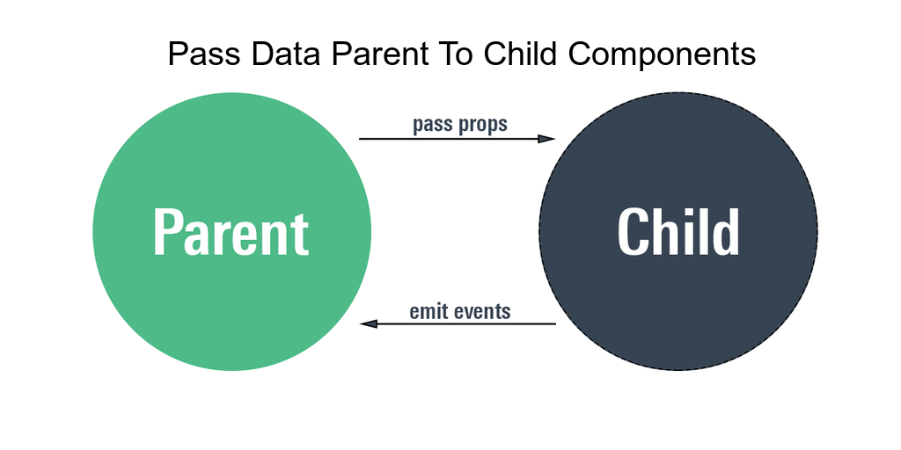

Slide 59
Container Component (stateful component)
Are concerned with how things work.
Provide data and actions to presentational components.
Are often stateful, as they tend to serve as data sources.

Slide 60
Presentational Component (stateless component)
Are concerned with how things look.
Usually have some DOM markup and styles of their own.
Receive data and callbacks exclusively via props.
Rarely have their own state (when they do, it’s UI state rather than data). A presentational Component is stateless

Slide 61
What are the benefits of using these patterns?
Better separation of concerns
Better reusability
Extract layout components to prevent duplication

Slide 62
TODO
Uitleg component
Uitleg data binding + 2 way databinding
@onBlur @onclick @onfocus. OF :onClick
Name, Props, data(), Methods, Computed() in Child components
Start app with root Vue: new Vue()
Computed properties en watchers

